Slide 1



Portfolio Management
Ankur Singh
Guided by Abhijeet Dalal

Slide 2


Agenda
Synopsis | 3
Current Scope | 4
ER Diagram | 5
Tech Stack | 6
Demo | 7

Slide 3
Synopsis
FundWise is a full-stack portfolio management platform, providing users with a hands-on experience in managing mutual fund investments. The website integrates a comprehensive set of features, including:
Secure Authentication to protect user data.
Fund Exploration with filters
Investment Tools like the ability to buy funds, view performance history, and track current investments.
A Fund Calculator to estimate potential returns
It helps users make informed decisions and manage their portfolio efficiently.

Slide 4
Scope
Authentication
Display all funds
Filters based on AMC, Risks, AUM
Allow user to buy a fund
View fund history
View user’s Investments
Fund Calculator
Search funds

Slide 5
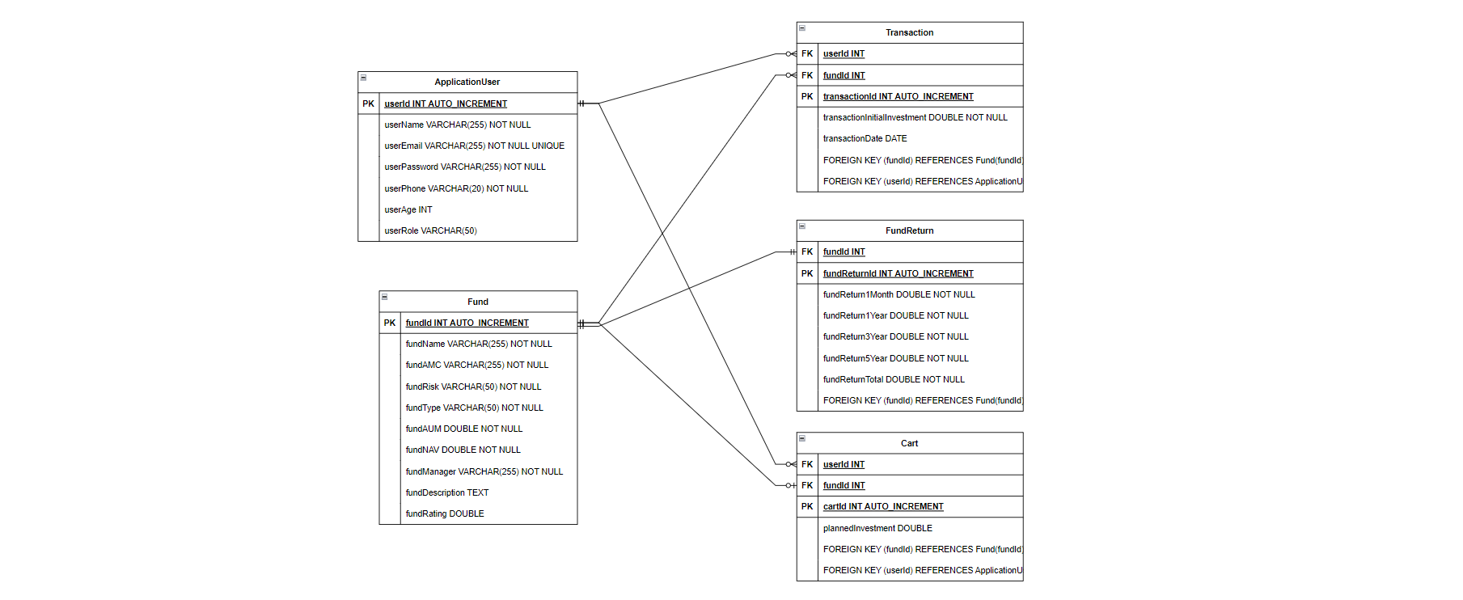
ER Diagram

Slide 6









Technology Stack
Spring Boot
Angular
JUnit & Mockito
Bootstrap
H2 Database

Slide 7
Demo

Slide 8

Questions?

Slide 9
Thank You

